Slide 1
Changeons & Predictons (in progress...)
Notes:
Presentation look and feel adapted from the “Brain” Microsoft Office Online template.
This is about several kinds of unity
If you are not interested in unity, then this talk may be superfluous
If you are so interested, then I have good and bad news
The bad news is that I paint an extremely depressing picture of today, and the near future
The good news is that “I have a plan”, and it does require philosophy and cognition to work more effectively together
And, of course, I could be completely bonkers like all other scare mongers

Slide 2
Taylor Series Expansion
Taylor Series
$f\left(x\right)=\sum_{n=0}^{∞}{\frac{f^{\left(n\right)}(a)}{n!}} {(x−a)}^{n}$
$e^{x}=1+\frac{x}{1!}+\frac{x^{2}}{2!}+\frac{x^{3}}{3!}+…, −∞<x<∞$
$\sim f\left(x\right)=\sum_{i=0}^{k}{a_{i}x^{i}}$
Leads to Newton’s Method of Divided Differences
Babbage’s Difference Engine
Errors accumulate beyond region x=a
My recurrence relation does not have this problem

Slide 3
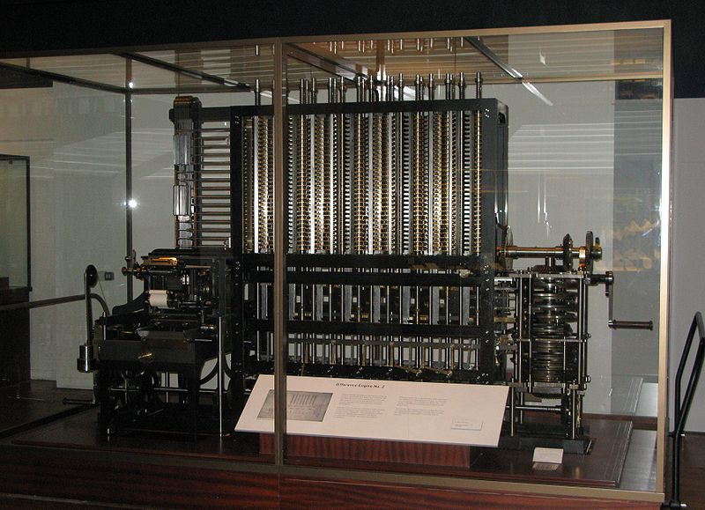
Babbage’s Difference Engine
Babbage’s
Difference Engine

Slide 4
Spreadsheet Difference Engine
t | t+noise | f(t) | P1: B+D+F+H+J+L | P2 | P4 | P8 | d1 | P1: D+F+H+J+L | d2 | P1: F+H+J+L | d3 | P1: H+J+L | d4 | P1: J+L | d5
-32 | -32 | -3170432 |  |  |  |  | 0 |  | 0 |  | 0 |  | 0 |  | 0
-31 | -31 | -1391776 |  |  |  |  | 1778656 |  | 0 |  | 0 |  | 0 |  | 0
-30 | -30 | 1.102319 |  |  |  |  | 1391777 |  | -386879 |  | 0 |  | 0 |  | 0
-29 | -29 | 1053976 |  |  |  |  | 1053975 |  | -337802 |  | 49077.43 |  | 0 |  | 0
-28 | -28 | 1815632 |  |  |  |  | 761656 |  | -292319 |  | 45482.96 |  | -3594.47 |  | 0
-27 | -27 | 2326969 |  |  |  |  | 511336.6 |  | -250319 |  | 41999.54 |  | -3483.42 |  | 111.0513
-26 | -26 | 2626625 | 2626613 |  |  |  | 299656.6 | 299644.4 | -211680 | -211692 | 38639.35 | 38627.18 | -3360.19 | -3372.37 | 123.224
-25 | -25 | 2750001 | 2750004 | 2749931 |  |  | 123375.9 | 123378.9 | -176281 | -176278 | 35399.35 | 35402.38 | -3240 | -3236.97 | 120.1918
-24 | -24 | 2729376 | 2729376 | 2729394 |  |  | -20624.6 | -20625.3 | -144001 | -144001 | 32280.18 | 32279.54 | -3119.16 | -3119.81 | 120.8417
-23 | -23 | 2594033 | 2594033 | 2594029 | 2593411 |  | -135343 | -135343 | -114719 | -114719 | 29281.86 | 29281.87 | -2998.33 | -2998.32 | 120.8356
-22 | -22 | 2370368 | 2370376 | 2370376 | 2370532 |  | -223665 | -223658 | -88321.5 | -88314.3 | 26397.11 | 26404.37 | -2884.75 | -2877.49 | 113.5775
-21 | -21 | 2082025 | 2082008 | 2082051 | 2082015 |  | -288343 | -288360 | -64678.4 | -64695.6 | 23643.11 | 23625.94 | -2754 | -2771.17 | 130.7442
-20 | -20 | 1750001 | 1750023 | 1749920 | 1750073 |  | -332024 | -332002 | -43680.9 | -43658.6 | 20997.47 | 21019.85 | -2645.64 | -2623.26 | 108.367
-19 | -19 | 1392777 | 1392756 | 1392890 | 1392936 | 1384533 | -357224 | -357245 | -25200 | -25220.7 | 18480.96 | 18460.2 | -2516.51 | -2537.27 | 129.1223
-18 | -18 | 1026432 | 1026446 | 1026322 | 1025830 | 1028847 | -366345 | -366331 | -9120.4 | -9106.43 | 16079.59 | 16093.57 | -2401.37 | -2387.39 | 115.1441
-17 | -17 | 664768.8 | 664760.5 | 664844.4 | 665661.7 | 664815.8 | -361663 | -361672 | 4681.233 | 4672.956 | 13801.64 | 13793.36 | -2277.95 | -2286.23 | 123.4209
-16 | -16 | 319424.6 | 319433.8 | 319384.2 | 318515.4 | 320367 | -345344 | -345335 | 16319.11 | 16328.34 | 11637.88 | 11647.11 | -2163.76 | -2154.53 | 114.1914
-15 | -15 | 0.115379 | -12.2014 | 43.17551 | 652.1443 | 1493.435 | -319424 | -319437 | 25919.74 | 25907.43 | 9600.63 | 9588.313 | -2037.25 | -2049.57 | 126.5082
-14 | -14 | -285823 | -285815 | -285889 | -286158 | -292885 | -285823 | -285815 | 33601.34 | 33609.63 | 7681.592 | 7689.889 | -1919.04 | -1910.74 | 118.212
-13 | -13 | -532168 | -532164 | -532114 | -531856 | -521243 | -246345 | -246341 | 39478.15 | 39482.1 | 5876.812 | 5880.767 | -1804.78 | -1800.83 | 114.2571
-12 | -12 | -734831 | -734849 | -734825 | -735340 | -746243 | -202663 | -202681 | 43681.79 | 43664.44 | 4203.642 | 4186.288 | -1673.17 | -1690.52 | 131.6112
-11 | -11 | -891175 | -891151 | -891255 | -890707 | -882686 | -156344 | -156319 | 46319.08 | 46343.87 | 2637.288 | 2662.084 | -1566.35 | -1541.56 | 106.8155
-10 | -10 | -1000000 | -1000023 | -999874 | -1000017 | -1004367 | -108824 | -108847 | 47519.68 | 47496.83 | 1200.607 | 1177.75 | -1436.68 | -1459.54 | 129.6728
-9 | -9 | -1061424 | -1061411 | -1061548 | -1061999 | -1057791 | -61423.9 | -61411.2 | 47400.52 | 47413.28 | -119.161 | -106.401 | -1319.77 | -1307.01 | 116.9128
-8 | -8 | -1076768 | -1076769 | -1076693 | -1075784 | -1082896 | -15344.3 | -15345.4 | 46079.65 | 46078.51 | -1320.87 | -1322.02 | -1201.71 | -1202.86 | 118.0593
-7 | -7 | -1048431 | -1048437 | -1048444 | -1049456 | -1042307 | 28336.9 | 28330.87 | 43681.17 | 43675.13 | -2398.49 | -2404.52 | -1077.62 | -1083.65 | 124.0913
-6 | -6 | -979775 | -979765 | -979801 | -979111 | -980628 | 68655.72 | 68666.05 | 40318.82 | 40329.15 | -3362.35 | -3352.01 | -963.859 | -953.527 | 113.7589
-5 | -5 | -874999 | -875013 | -874951 | -875142 | -881583 | 104776 | 104762.1 | 36120.28 | 36106.37 | -4198.54 | -4212.45 | -836.192 | -850.1 | 127.6673
-4 | -4 | -739024 | -739010 | -739094 | -739214 | -727065 | 135975.7 | 135989.2 | 31199.73 | 31213.22 | -4920.55 | -4907.06 | -722.014 | -708.524 | 114.178

Slide 5
Process Network Example
Automatically generates missing info
blink
Optical blind spot
Continuous Interaction
Bottom-up
Top-down
Incremental Learning of Dynamics
Not solution
No substance (weights)
Adaptive
Incremental Levels
Improve accuracy
No Delay
8 Spreadsheet Columns
Delay
Need Network
+Efferents
Far Predictors
Not needed
dPrv
dNow
dErr
dF_{3,2}=2
dF_{3,1}=5
dF_{3,0}=14
pF_{3,1}=42
pF_{3,2}=90
pF_{3,3}=165
Level 3
t-7
t-6
t-5
vPrv
vNow
vNxt
dPrv
dNow
dErr
dF_{2,1}=2
dF_{2,0}=5
pF_{2,1}=14
pF_{2,2}=28
pF_{2,3}=48
Level 2
t-5
t-4
t-3
vPrv
vNow
vNxt
Level 1
dPrv
dNow
dErr
dF_{1,0}=2
pF_{1,1}=5
pF_{1,2}=9
pF_{1,3}=14
Detectons/Changeons
t-3
t-2
t-1
vPrv
vNow
vNxt
dPrv
dNow
dErr
pF_{0,1}=2
pF_{0,2}=3
pF_{0,3}=4
Level 0
t-1
t
t+1
vPrv
vNow
vNxt
f(t) = at³ + bt² +ct + d
Value In(t)
dNow
dNow
dNow
Predictons
t+2
t+3
t+4
vNxt
vNxt
vNxt
Level 1
Level 2
Level 3
Prediction Out(t+1)

Slide 6
Changeon
dPrv_{n} = vPrv_{o} – vNow
vPrv_{n} = vNow
vNxt = vNow + dNow
dErr = vNxt – vNow (unused)
dPrv
dNow
dErr
t-3
t-2
t-1
vPrv
vNow
vNxt

Slide 7
Kalman Filter
Kalman Filter
Use: predict values with random noisy measurements over discrete time increments (especially in military radar); sensor fusion; data fusion
E.g., phase locked loop
Exact inference in a linear dynamical system
Weighted average of predicted and measured values (covariance)
Bayesian Model over a Hidden Markov Model of latent variable states considered to Gaussian (normal) distribution
Recursive filter
Predict/update cycles

